Slide 1
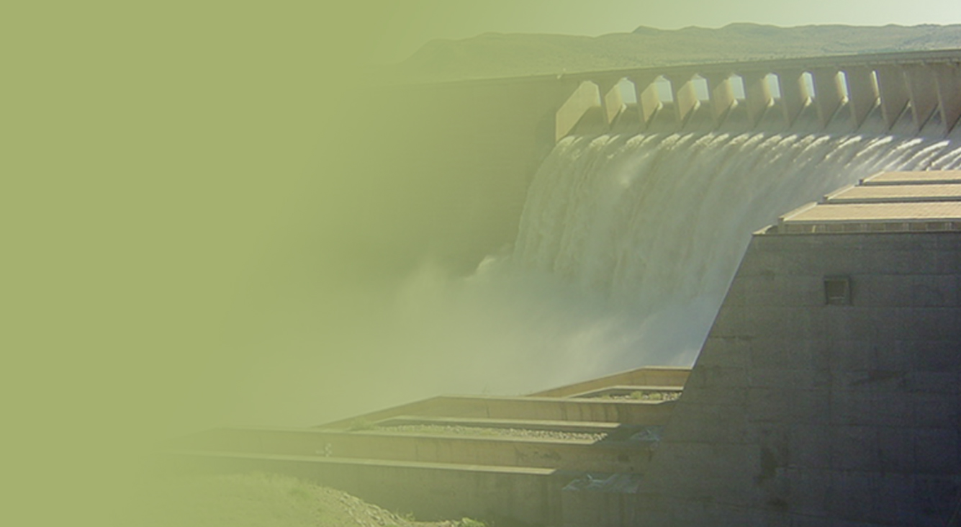
Determination of Water Resource Classes & Associated Resource Quality Objectives (RQOs) in the Mzimvubu Catchment
Presented by:
Lawrence Mulangaphuma
Department of Water & Sanitation
Date: 15 May 2018
PRESENTATION TITLE
Presented by:
Name Surname
Directorate
Date

Slide 2
Presentation Content
Legal Mandate
Resource Directed Measures
Process for the determination of Water Resources classes and Resource Quality Objectives
Project progress
Current classification step
Stakeholder Engagement Plan
Purpose of PSC 4 meeting

Slide 3
Legal Mandate
Chapter 3 of the National Water Act (No. 36 of 1998), deals with the protection of water resources
The measures for protection of water resources are:
Classification (S13)
Reserve (S16)
Resource Quality Objectives (S13)
S12 requires the Minister to establish the Water Resource Classification System, (WRCS)
WRCS was published as Regulation 810 in Government Gazette No. 33541 dated 17 September 2010
The WRCS defines:
water resource classes and
the procedure to determine Class, RQOs and Reserve
According to the NWA, once the WRCS has been gazetted all significant water resources must be classified and Resource Quality Objectives determined

Slide 4
Contextualizing Resource Directed Measures

Slide 5
Determination of Water Resource Classes
Classification defines the desired state of the water resources by setting Water Resource Classes;
Each class represents:
a different level of protection that is required for the water resource, and
the extent to which the water resource can be used.
Classification is used in two ways:
To describe the present status of the water resource
To describe the state towards which the water resource needs to be managed sustainably (future state).
Surface water, groundwater, wetlands, estuaries
 | Description of use | Majority of ecological categories
Class I | Minimally used | A-B
Class II | Moderately used | C
Class III | Heavily used | D
Ecological Category (EC) - means the assigned ecological condition to a water resource . It is measured by determining how much the ecosystem has changed from natural (pre-development condition). The scale is A (near natural) to F (critically modified)
5

Slide 8
Project progress
DELIVERABLES | DUE DATE | STATUS
1. Inception report | November 2016 | Completed
2. Survey report | October 2016 | Completed
3. Status Quo and IUA and RU delineation report | March 2017 | Completed
4. Estuary workshop and report | June 2017 | Completed
5. Desktop EWR and System Modelling reports | May 2017 | Completed
6. Basic Human Need report | July 2017 | Completed
7. River EWR report | July 2017 | Completed
8. Groundwater report | September 2017 | Completed
9. Wetland ecoclassification report | August 2017 | Completed
10. Estuary EWR report | August 2017 | Completed
10. Ecological consequences report | October 2017 | Completed
11. Scenario consequences evaluation report | January 2018 | Completed
13. Non- Ecological consequences report | March 2018 | Completed
14. WRC and catchment configuration report | March 2018 | Completed
15. River and estuary RQO report | April 2018 | In progress
16. Wetlands and groundwater RQOs report | April 2018 | In progress
17. Monitoring programme to support RQOs implementation | May 2018 | Outstanding
18. Water resource classes and RQOs Gazette Template input | May 2018 | Outstanding
19. Main and Close out report | July 2018 | Outstanding
20. Issues and Response report | July 2018 | Outstanding

Slide 9
Completed step (1)

Slide 10
Completed step (2)

Slide 11
Current classification step: RQOs (1)
Purpose → “establish clear goals relating to the quality of the relevant water resources”
In determining RQOs, “a balance must be sought between the need to protect and sustain water resources and the need to use them”
Numerical and/or descriptive statements and may relate to quantity, quality, habitat and biota.
Must take account of user requirements and the class of the resource
Binding on all authorities and institutions
11

Slide 12
Current classification step: RQOs (2)
Water Resource Class
Operational Scenario/s
Informs
Defines
RQOs

Slide 13
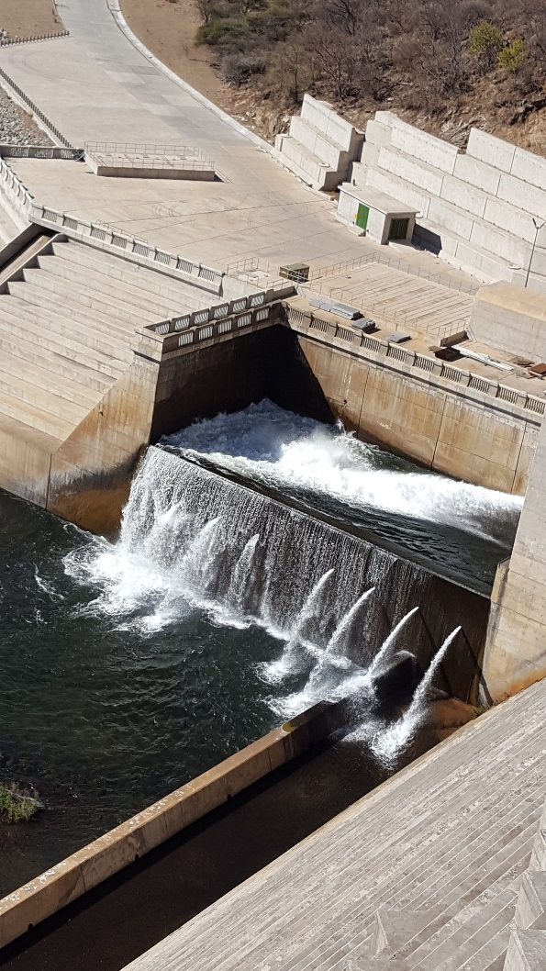
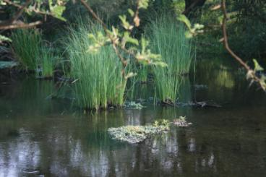
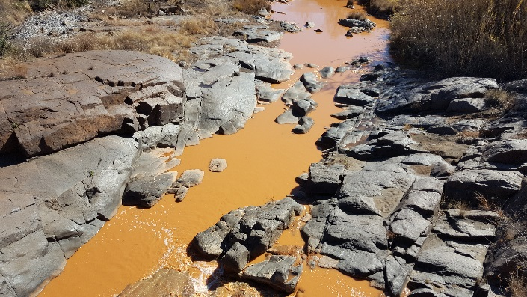
Resource Quality Objectives Outcome
The study should provide statements about:
what the quantity of the water should be (water level, pattern, timing)
what the water quality should be (physical, chemical and biological
what the condition of the instream and riparian (river bank) habitat should be
what the condition of the aquatic (water) animal and plant life should be.
Releases are looking good
This is perfect for me
HELP!!
13

Slide 14
Stakeholder Engagement Plan
Platforms | Stakeholder groups | Purpose
Project Steering Committee | Representatives from various Sectors | To give strategic inputs to the project PSC 1 (05/12/16), PSC 2 (18/07/2017) and PSC 3 (13/02/2018)
Technical Task team Meeting | Representatives from sectors with technical knowledge of study area and water resource management | To source comments and inputs on technical aspects of the project TTG: WQ info was held on 31/01/17
Public Meetings | The broader public | To announce the project To present the proposed classes & RQOs (End of the project: 05 & 06 June 2018)
Forums | Catchment management forums | Information sharing UCPP held on 11/04/18
Sectors | Different sectors e.g. Domestic, Agriculture, mining etc. ( where necessary). | Information sharing

Slide 15
Purpose of the PSC 4 meeting
An overview of finalized Water Resource Classes
Groundwater information gathered for the study
Wetland information gathered for the study
Resource Quality Objectives (RQOs) for rivers, estuary, groundwater and wetlands

Slide 16
Further information
For more information:
Register on project specific web-site or email:
https://www.dwa.gov.za/rdm/Documents.aspx
For more information contact:
Project Team: Patsy Scherman (patsy@itsnet.co.za)
DWS (Pretoria): Lawrence Mulangaphuma (mulangaphumal@dws.gov.za)

Slide 17
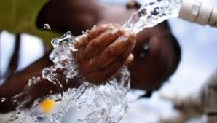
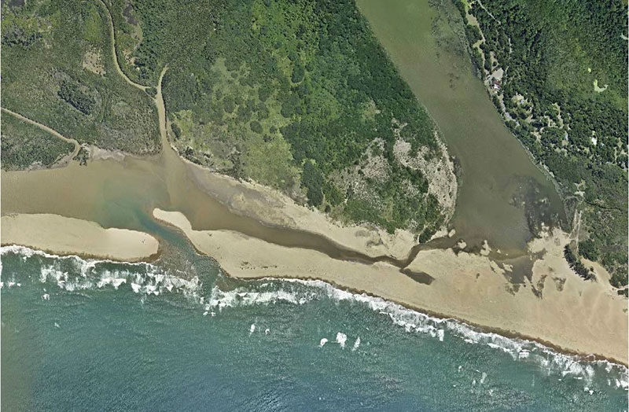
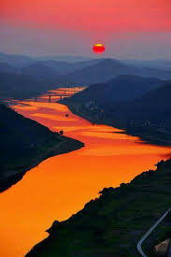
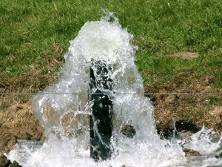
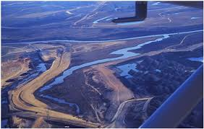
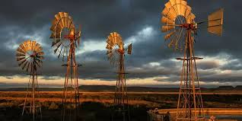
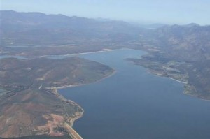
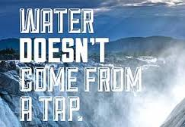
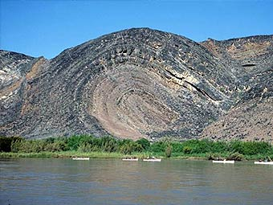
THANK YOU!
Estuaries
Rivers
Groundwater
Wetlands
Dams

